Slide 1
#Decorator Pattern
Intro
Hook
Explore
Explain
Apply
Share
Evaluate
Expand
Presenters:
Huỳnh Lê An Phú – 10421100
Phan Tâm Như - 10421122

Slide 2
#Table of Contents
Intro
Hook
Explore
Explain
Apply
Share
Evaluate
Expand
1. Overview
2. Implementation

Slide 3
The Starbuzz Coffee overview
Intro
Hook
Explore
Explain
Apply
Share
Evaluate
Expand
Beverages - Espresso 1.99 - Dark Roast .99 - House Blend .89
Condiments - Milk .10 - Mocha .20 - Soy .15 - Whip .10

Slide 4
Decorator Pattern
Intro
Hook
Explore
Explain
Apply
Share
Evaluate
Expand
Definition
The Decorator Pattern attaches additional responsibilities to an object dynamically.
Decorator Pattern is a structural pattern.

Slide 5
Decorator Pattern
Intro
Hook
Explore
Explain
Apply
Share
Evaluate
Expand
When to use
To add responsibilities to individual objects dynamically and transparently, without affecting other objects.
Remove functionalities/responsibilities dynamically.
Avoid too much of sub-classing to add additional responsibilities.

Slide 6
Decorator Pattern
Intro
Hook
Explore
Explain
Apply
Share
Evaluate
Expand
Pros and Cons
Can extend an object’s behavior without making a new subclass, add or remove responsibilities from an object at run time.
Can combine several behaviors by wrapping an object into multiple decorators.
Overused of Open-Closed principle.
Too many small classes add maintenance overhead.

Slide 7
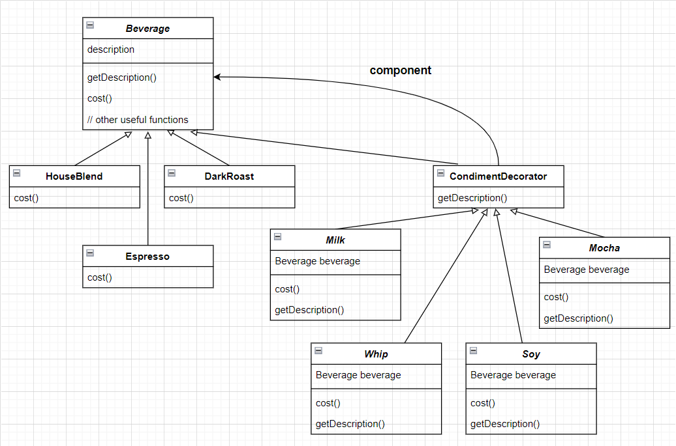
Intro
Hook
Explore
Explain
Apply
Share
Evaluate
Expand
Class Diagram

Slide 8
Explain
Intro
Hook
Explore
Explain
Apply
Share
Evaluate
Expand
Beverage
The interface of the app. Contain the descriptions of each beverages and cost() function.
Can also contain other useful functions.

Slide 9
Explain
Intro
Hook
Explore
Explain
Apply
Share
Evaluate
Expand
CondimentDecorator
- Components that are added to beverages.
- Each components contain two functions: getDescription() and cost().

Slide 10
Description
Intro
Hook
Explore
Explain
Apply
Share
Evaluate
Expand
Create an application that can add condiments into beverages and execute functions accordingly.

Slide 11
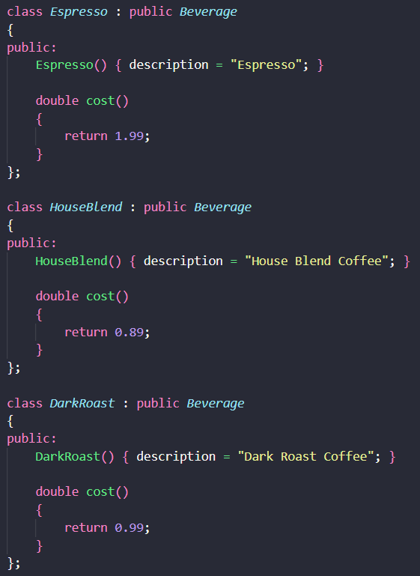
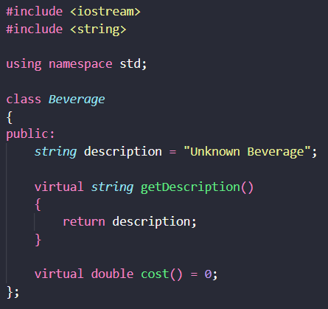
Implementation (Beverage)
Intro
Hook
Explore
Explain
Apply
Share
Evaluate
Expand

Slide 12
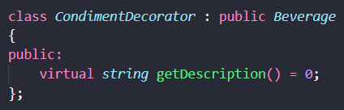
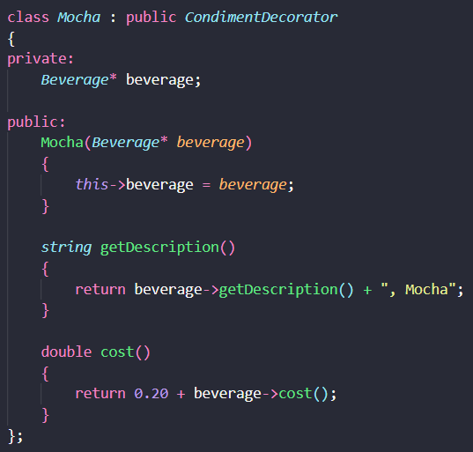
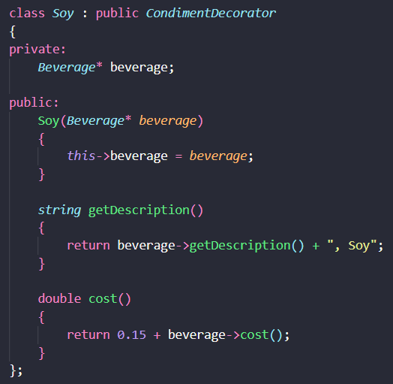
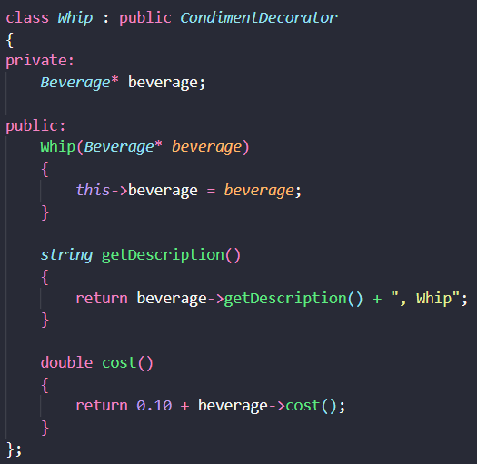
Implementation (Condiment Decorator)
Intro
Hook
Explore
Explain
Apply
Share
Evaluate
Expand

Slide 13
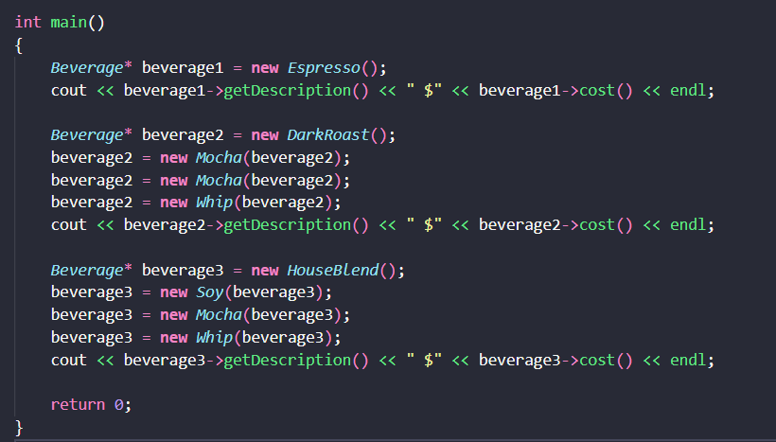
Implementation (main function)
Intro
Hook
Explore
Explain
Apply
Share
Evaluate
Expand

Slide 14

Implementation (output)
Intro
Hook
Explore
Explain
Apply
Share
Evaluate
Expand

Slide 15
#Thanks!

